Slide 1









Identifying K-12 Access to Healthy Food via Community-Led Grocery Store in Schools

Slide 2
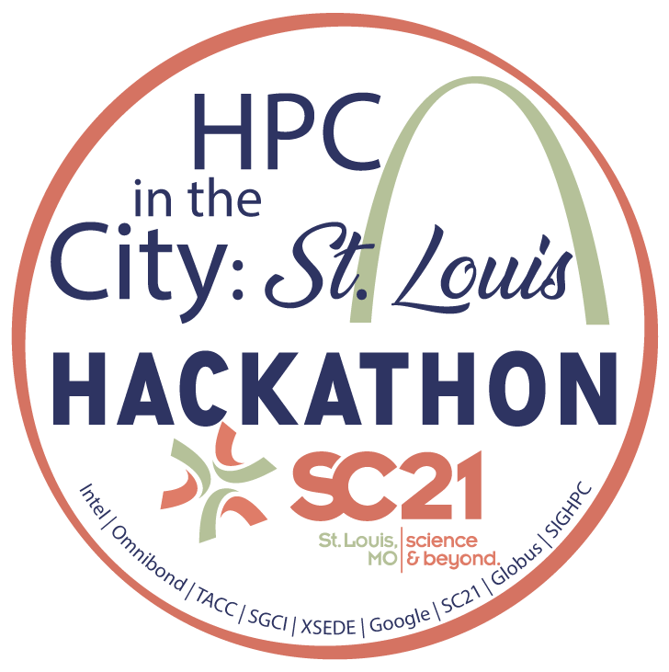
Project Name
Edgar Garza(TACC)
Email: egarza@tacc.utexas.edu
Discord: obscure cynic#0079
How can St. Louis-area school districts and community-based organizations identify food deserts, by leveraging census/poverty data and equity indicators (food insecurity, health food access) to create community-led grocery stores in schools.
As of 2017 in St. Louis, black families are nearly six times as likely as white families to receive food stamps and twice as likely (than white residents) to live in census tracts with low access to healthy food.
Google Cloud and Jupyter Notebooks
Python, R, Web Dashboards

